Slide 1






BUILDING SUPPORT AMONG CALIFORNIANS
FOR COLLEGE AFFORDABILITY:
A Messaging Guide

Slide 2
Table of Contents
Guide at a Glance | Page 3
About This Guide | Page 8
Messaging Recommendations & Audience Insights | Page 11
Activating the Messaging: Recommendations & Examples:
Build Trust | Page 13
Acknowledge Complexities, Calm Concerns | Page 19
Nurture Compassion | Page 23
Elevate Solutions | Page 28
Appendix: More About this Guide & Additional Resources | Page 32
Appendix: Research | Page 38
Notes:
Add note: change goals identified by research advisors and haas fund staff

Slide 3

Guide at a Glance

Slide 4


Who should use this guide?
GUIDE AT A GLANCE
This guide is for everyone who is working to increase support for making college more affordable in California. Whether your work is in direct services, policy and advocacy, research, grantmaking, or a combination of these areas, this guide can help you develop communications to effectively mobilize diverse audiences to take action.
This guide can help you:
Persuade policymakers — through advocacy days, one-on-one meetings, legislative advocacy campaigns, and more
Connect with voters (the general public) — through op-eds, media placements, social media, videos, website landing pages and blog posts, and more
Engage your supporters — through annual reports, email blasts, virtual and in-person events, social media, videos, website landing pages and blog posts, and more
Feel free to use some — or all — of this deck as needed for the work you and your organization are doing. Share the whole thing with your colleagues, or pull out just the slides best suited to their work.
PRINCIPLES IN PRACTICE
As you read this guide, look for the Principles in Practice for practical tips to apply the recommendations to your work.
4

Slide 5
Understanding Audiences and the Public Conversation About College Affordability
GUIDE AT A GLANCE
This guide contains messaging recommendations and examples on how to build support among civically engaged Californians of different political orientations, genders, and races/ethnicities for policies to increase the affordability of and access to college education. Recommendations and examples are based on research conducted by the public opinion research firm Goodwin Simon Strategic Research in partnership with Wonder: Strategies for Good, a social change communications firm.
What we learned about audiences:
In general, people
support programs to
provide students with the full financial resources
they need to attend
college, and agree that giving more people opportunities to attend college helps foster a more equal and fair society.
Increasing support for college aid, however, is a complex conversation: Audiences are concerned about increased taxes and question whether it's fair for those who didn’t go to college to pay for those who do.
People believe colleges should justify their costs, be more transparent and clearly publish their actual costs to students and the government, and be clear about what financial aid grants cover and don’t cover.
Many people question whether a college degree is still worth it — messaging with clear evidence showing that college affordability programs work make audiences more likely to support them.
Providing clear evidence that going to college
is worth it and has advantages for the financial future of students is essential for people to support the increase of grants.

Slide 6




EMPOWER AUDIENCES TO ARRIVE AT SUPPORT FOR EFFECTIVE SOLUTIONS
A Heartwired Framework to Build Support for College Affordability
The Heartwired Framework is a set of four strategic principles for you to consider when creating messaging to build support for college affordability solutions. These principles were developed based on the research conducted for this project and are informed by the science of how people relate to and make decisions about social issues.
Often, advocacy communications and messaging tells audiences what to think and how to act. For audiences who are undecided or conflicted, being told what to think and how to act can trigger counter-arguing. They will disagree because psychologically they do not like the idea of having their agency taken away. Messages that take these factors into account can lead to longer-term change because they engage an audience’s agency in arriving at support for effective solutions.
01
02
03
04
Build
trust
Acknowledge complexities, calm concerns
Nurture
compassion
Elevate
solutions
Establish trust to effectively communicate with and persuade your audience.
Address the powerful emotions audiences have on this subject so they can be reflective and thoughtful about new ideas or solutions.
Show audiences the harms caused by the runaway costs of college and why they should care.
Inspire optimism and hope about potential policies and proven solutions.

Slide 7
About This Guide

Slide 8





Change Goals
Advocates working on college affordability identified strategic goals to make progress on college affordability in California. This research was conducted to support advocates make progress toward the following goals:
Inspire long-term movement to ensure college is more affordable and accessible for students across the state. Ensure that key stakeholders understand that college affordability reflects the reality of all the costs associated with college (not just tuition).
Reduce racial and economic equity gaps in enrollment, completion and borrowing.
Motivate state policymakers to increase and strengthen funding for higher education and financial aid (including creating dedicated funding streams), and prioritize higher education in budget agreements, especially in the face of an economic downturn.
Develop communications and advocacy infrastructure and outreach to encourage Californians to take advantage of any available federal loan forgiveness and federal and state consumer and civil rights protections.
Ensure that California’s new financial aid application completion requirements are implemented and no financial aid is left on the table.
These change goals were developed with Evelyn & Walter Haas, Jr. Fund staff and project advisors.
For a full list of our advisors,
see Page 34.

Slide 9

THE FIVE HEARTWIRED FACTORS
What we listened for in this research
This messaging guide is based on understanding how human beings
are heartwired.
When it comes to making emotionally complex decisions, people are heartwired. Five heartwired factors — emotions, identity, values, beliefs, and lived experiences — combine and also collide to shape how people think and behave.
When there is alignment between all five heartwired factors, decisions are straightforward. When there are conflicts, decisions can be more difficult.
Emotions
Feelings in response to stimuli. Emotions drive behavior particularly when we feel threatened and need to make split-second decisions.
Lived
Experiences
Meaning made from events and relationships that a person experiences in their life.
Identity
How one sees oneself in relation to the world. Identity incorporates many facets and traits.
Values
Ideals held about good and bad, right and wrong. Values influence emotions, beliefs and behaviors and are often shared within a culture or community.
Beliefs
Ideas held to be true. When we have little experience with something, we tend to fill in the knowledge gaps with assumptions.
Sources: Wonder: Strategies for Good, Goodwin Simon Strategic Research
9

Slide 10

THE FIVE HEARTWIRED FACTORS
What we listened for in this research
Emotions
People experience the full breadth of emotions around education and college affordability — including anger at the cost of college, fear among parents they won’t be able to help their children, or distrust of government generally. Overcoming emotional hurdles is critical to building support for effective college affordability solutions.
Lived Experiences
People’s experiences with education and work impact their decisions about supporting college affordability programs. For example, if audiences know someone who has succeeded without attending college, they may be less likely to feel that college is necessary to create economic mobility. That, in turn, may negatively impact their support for public investment in making college affordable.
Identity
People's economic class, community, and political identities are all at play when they think about college affordability. For example, parents identify strongly with other parents who make sacrifices to provide for their children.
Values
People's values — such as the importance of hard work and taking care of their families — can strongly shape how they respond to certain messages and messengers. Messages that lift up stories of hard work and sacrifice resonated with these values for many audiences.
Beliefs
When it comes to college affordability, people's beliefs about government are powerful influences. Some people are very skeptical of the government's ability to solve any problem, which makes it important to lift up solutions that are already working and how we can build on them.
Emotions
Lived
Experiences
Identity
Values
Beliefs
Sources: Wonder: Strategies for Good, Goodwin Simon Strategic Research
10

Slide 11

Messaging Recommendations
& Audience Insights
11

Slide 12
About These Recommendations
In the following pages, we'll dive further into the Four Heartwired Principles. For each, we will:
Explain the underlying theory
Share insights into the supporting research
Offer recommendations based on our findings
Provide example messages so you can see these concepts in action
A few things to note as you read:
Messages are ingredients, not the whole meal. In other words, you will need to adapt messages for different forms of communication — like speeches, opinion pieces, and video stories — not have them stand alone. Messages can also be combined with other ingredients, like data points, stories, and calls to action (for policy change or activism) or requests for proposals.
Not every piece of messaging or content will address every principle of the Heartwired Framework. But when you evaluate your overall communication strategy, you should understand and apply all of the principles at various points throughout your efforts.
Some messages may align with more than one principle. For example, a message might serve to both build trust with audiences and calm their concerns.
Who delivers these messages is often as important as the messages themselves.
Messengers should personalize the messages they deliver. When messengers share their motivations for speaking out, and those motivations align with the values of our audiences, messengers are seen as more relatable and trustworthy. As an advocate, you can prompt messengers to express their motivations to help foster a sense of connection between messengers and audiences.
As you evaluate your current communication strategy, consider how your messages are — or aren't — meeting the emotional needs of your audiences. Put yourself in your audiences' shoes to assess how they will relate to, and understand, your messaging.

Slide 13


A HEARTWIRED FRAMEWORK TO BUILD SUPPORT FOR COLLEGE AFFORDABILITY
PRINCIPLES IN PRACTICE
Build Trust
Let’s say you want to draft an op-ed talking about the importance of college affordability. The first paragraph of that op-ed is a critical opportunity to build trust by identifying your author, why they're speaking out, and how your audiences can relate to them.
Building trust is an important prerequisite to effectively communicating with and persuading your audience. There are many factors that help establish trust, including who speaks out on an issue, their motivation, and the language they use to explain the issue.
When audiences trust and relate to messengers, they are more likely to believe and agree with the information and anecdotes they share. Use plainspoken, easy-to-understand language in place of jargon to avoid creating emotional distance between advocates and audiences, which can fuel distrust.

Slide 14
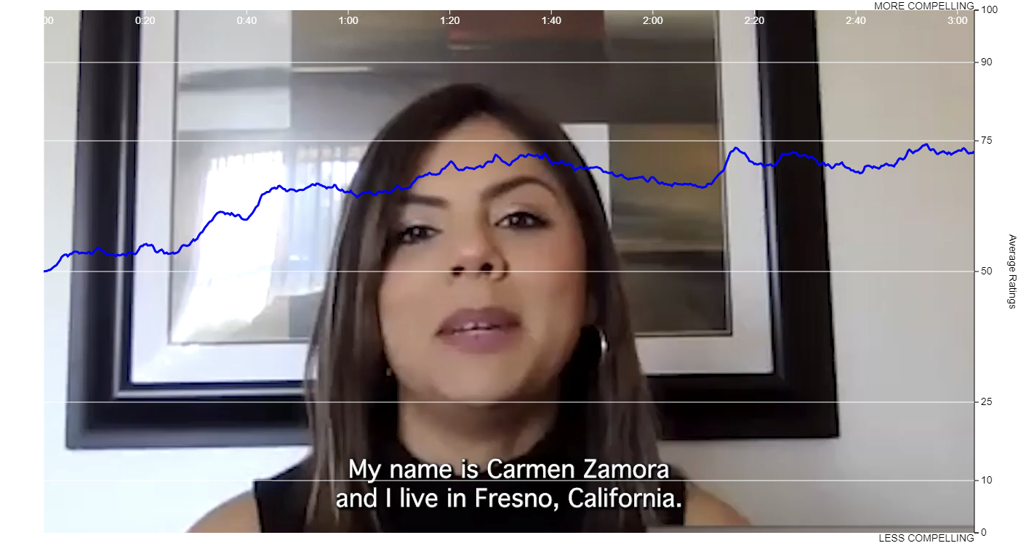
BUILD TRUST
Research Insight
Messages from parents help build support for college affordability solutions among engaged Californians.
MORE COMPELLING
In an online survey,
79% of respondents agreed that hearing from Carmen, a parent whose video message we tested, helped them consider their own feelings and thoughts about college affordability.
Hearing Carmen’s story increased support among many participants because her experience made her relatable and therefore a trusted messenger. This graphic shows how support increased as audiences watched the video. Support increased at key moments when she made herself relatable to other Californians.
This graphic shows how support increased as audiences watched the video.
LESS COMPELLING

Slide 15

BUILD TRUST
Research Insight
Messenger Moments That Build Trust | Why the Message is Effective
Her three children attended schools in their local community of Fresno and her older children are attending college in Fresno as well. | By sharing details about who she is, where she lives, and where her kids are going to school, Carmen comes across as a real person — not an actor. Hearing that Carmen’s children are attending school locally may also have helped the audience understand that they were making “responsible” decisions about what they could afford.
She worries that government financial aid systems penalize working- and middle-class families like her own —she makes too much money to be eligible for government financial aid but not enough to help her kids pay for college. | Carmen facilitates identification with a broad cross-section of Californians by relating her struggles with those of other working- and middle-class families.
She feels it is the duty of parents to learn how to navigate financial aid systems to better support their children. | Being a parent is also one of the most widely shared identities on the planet. By speaking as a parent — especially naming the responsibilities of being a parent —Carmen becomes more relatable and trusted to a broad range of audiences.
She ends by saying that we all want better lives, and programs that help working- and middle-class parents support their children’s college education can help. | Carmen ends by expressing a value that resonates for many — wanting a better life for their children — while connecting that to the identities of working- and middle-class parents.

Slide 16
BUILD TRUST
Research Insight
IMPEDIMENTS TO BUILDING TRUST
Of course, no message is perfect, and while it was ultimately persuasive for audiences, there were elements of Carmen’s stories that did not work and created impediments to building trust. For example, when Carmen mentioned that she was divorced, there was a significant drop in support among viewers. We can speculate about reasons for that — some viewers might believe that marriage is permanent and not support divorce; others may be divorced and it raises unpleasant feelings for them.
The takeaway for your messaging efforts: Don’t include any extraneous information that’s not key to the story you’re telling, as doing so can distract your audience.
Later in the video, Carmen said “And now I work for a nonprofit where we work in advocacy…” The mention of “advocacy” coincided with a significant drop in support. This may be because people associated this word with divisive political issues. Carmen continued to describe the work itself, saying that it consisted of “...helping families understand how the school system works so that they can learn how to navigate the system.” Upon hearing this, support not only recovered but increased.
The lesson here is to avoid using words that may be loaded or easily open to misinterpretation.
In both instances, these details led audiences to be unnecessarily judgmental, reduce their faith and trust in the messenger, and separate them from the speaker and their story. Fortunately, in each instance that trust was recovered but the lessons are important to keep in mind.

Slide 17


BUILD TRUST
BUILD TRUST
Messaging Recommendations
Deploy parent messengers who work in relatable jobs and want to do right by their kids to help ensure their future success.
Show audiences the hard work required to attain a college degree by spotlighting student messengers who are committed to their education and motivated to succeed.
Elevate stories of hard-working California families — linking their success with the state’s success.
Feature students who want to go to California public colleges and steer clear of stories where for-profit private colleges are prominently featured.
Connect the values of hard work and setting goals to the benefits of college, career, and beyond.
Crafting effective communications goes beyond just the words we use. When crafting your messages, consider all the factors that influence how audiences will perceive them, such as: the diversity of messengers (race, ethnicity, gender, geography, socio-economic status); details about where they live, work, and go to school; and, for stories using video, where they are while being interviewed (school, work, at home with their family).

Slide 18

BUILD TRUST
Messaging Examples
As parents, my husband and I worked really hard so our kids would have opportunities we didn’t, including a good education.
We all aspire to better lives. A college degree or a professional training certification can help people do that.
We should make it easier for California families access to financial aid, which will ensure that California’s diverse economy is able to grow and thrive.
College degrees and professional certifications are still one of the best ways for young people to achieve economic and life success.
Parents who are working hard to ensure that their kids get a good education deserve support.
These days, working- and middle-class families are finding college to be unaffordable. Even when parents work hard and make sacrifices, they can find that they don’t make enough money to cover all college costs. Yet, they often make too much money to qualify for state and federal financial aid.

Slide 19

A HEARTWIRED FRAMEWORK TO BUILD SUPPORT FOR COLLEGE AFFORDABILITY
Acknowledge Complexities, Calm Concerns
PRINCIPLES IN PRACTICE
This principle can be particularly important in a face-to-face meeting, for example with a policymaker or a parent. Before you get to making your case, you're very likely to have to acknowledge the other person's concerns and address some of the complexities they see.
When audiences’ brains are flooded with negative emotions it is difficult to be reflective and thoughtful about new ideas or solutions. This principle acknowledges people’s negative feelings, which helps them to manage these negative emotions. That, in turn, makes them more open to listening, learning, and hearing promising solutions.
Listening to people and hearing their concerns does not require agreeing with those concerns or beliefs. It does requiring demonstrating that you are listening and recognizing their concerns, even if you don’t agree with them. Doing this helps audiences to manage any negative emotions that might otherwise hijack their ability to be thoughtful, reflective, and compassionate.
For more about how our brain reacts to negative emotions — and how it impacts our communications efforts — see pages 36-37 in the Appendix.

Slide 20


ACKNOWLEDGE COMPLEXITIES, CALM CONCERNS
Research Insight
While the majority of Californians we surveyed agree that a four-year college degree is valuable, most also agree that college isn’t affordable today. Survey respondents indicated strong support for policies requiring colleges to more clearly publish their actual costs to students and the government, in the hopes that more transparency will push tuition prices down.
Nearly 9 in 10
find a four-year college degree valuable
More than 3 in 4 say college isn’t affordable today
Nearly 9 in 10
strongly favor requiring colleges to more clearly publish their actual costs to students and the government, in the hopes that more transparency will push tuition prices down
20

Slide 21

ACKNOWLEDGE COMPLEXITIES, CALM CONCERNS
Messaging Recommendations
Acknowledge the anger/frustration with rising costs in general, particularly colleges’ lack of transparency in justifying costs.
Demonstrate how access to a college education has become increasingly unaffordable for working- and middle-class families.
Share a few key facts to illustrate the complexity of state and federal financial aid, and how they are outdated.
Emphasize the cost of college today — including housing, food, and books — and show that state and federal grants don’t cover many of these costs.
Signal openness to proposals requiring colleges to publish their actual costs to students and the government as a way to lower tuition.
Address concerns about whether college is “actually worth it” head on, highlighting proven economic benefits for graduates, their families, and their communities.

Slide 22

ACKNOWLEDGE COMPLEXITIES, CALM CONCERNS
Messaging Examples
The federal and state programs that help students pay for college, while valuable, are outdated and overly complex.
For students from working- and middle-class families who want to go to college, tuition and the cost of living have made it unaffordable. It doesn’t help that the financial aid system is complicated and outdated.
It may seem like a college degree is less valuable these days, however, individuals with a community college degree will actually earn $400,000 more over their lifetime. Those with a bachelor’s degree will earn $1,000,000 more over their lifetime.
We need to fix what’s broken about our higher education system. We need more transparency about why some colleges cost more than others, so students and their families can make informed decisions about what is best for them.
We also need policies that fix outdated eligibility requirements for state and federal financial aid, so these dollars keep pace with inflation and rising costs everywhere.

Slide 23

A HEARTWIRED FRAMEWORK TO BUILD SUPPORT FOR COLLEGE AFFORDABILITY
PRINCIPLES IN PRACTICE
Using photos of real people and the human impact of your work is a great way to nurture compassion. If you're planning an email blast, a social media post, or an annual report, avoid stock photos and seek out photos that capture the real people involved in and benefiting from your work.
Nurture Compassion
Nurturing compassion is about showing audiences the harms caused by the runaway costs of college and why they should care. One way we can do so is by showing how those who would benefit from programs to make college affordable are part of our audience’s “ingroup.” An ingroup is social group to which a personal psychologically identifies as being a member. Ingroup members have positive views of one another, and are more likely to care about treating ingroup members fairly and compassionately — making audiences more open to solutions that would make college more affordable.

Slide 24
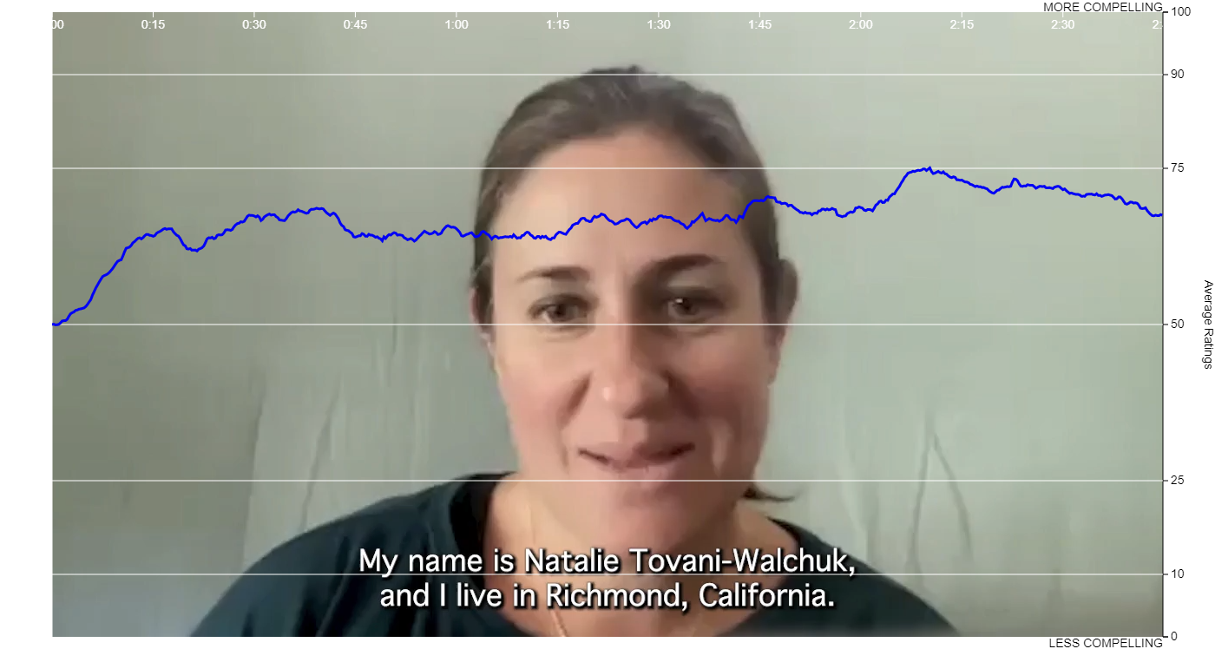
NUTURE COMPASSION
Research Insight
In an online survey, respondents’ support for college affordability programs increased after learning more about how increasing costs have negatively impacted California families.
As an example, we showed respondents a video in which Natalie, a parent, shared her experience of going to great lengths to support her children's education.
This graphic shows how support increased as audiences watched the video. Support increased when Natalie helped viewers understand the real challenges facing California families struggling with the cost of living in our state, which helped audiences see themselves in her story. This was true even of audience members who didn’t share other characteristics with Natalie, like race and ethnicity, gender, or political ideology.
MORE COMPELLING
LESS COMPELLING
This graphic shows how support increased as audiences watched the video.

Slide 25
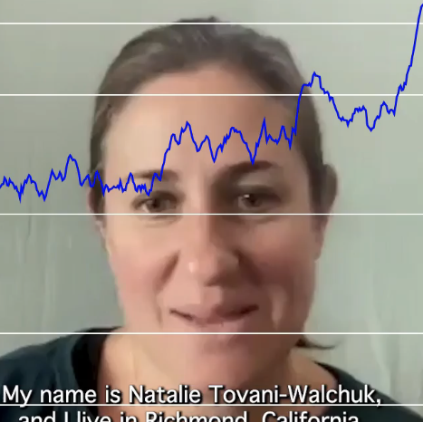
NUTURE COMPASSION
Research Insight
How Natalie Nurtured Compassion and Got Folks to Care | Why the Message is Effective
Natalie directly identifies herself as middle-class. | By sharing details about where she fits in California’s economy, Natalie allowed large swaths of the audience to identify with her.
She talked about the cost-of-living crisis in California and how more needs to be done to address these challenges when it comes to college affordability. | Natalie names a common problem with which people relate and empathize, and lets viewers know she’s also a Californian with problems similar to theirs, further cementing ingroup dynamics.
She shared that, after learning that her family was ineligible for government financial aid for college, she sold her house and used the profit to help pay for her children’s education. | Natalie’s dramatic efforts to provide for her family struck a chord with audiences who saw her as part of their ingroup working hard to get ahead and, for some, as a parent willing to make big sacrifices to fulfill their duty to their children.

Slide 26

NUTURE COMPASSION
Messaging Recommendations
Bring beneficiaries of programs to support college affordability into the ingroup by spotlighting racially and geographically diverse messengers
and highlighting shared characteristics, life experiences, values,
and motivations.
Place college students and prospective college students in the context of their families and communities.
Highlight stories of how college helped young people achieve financial independence and pass on the same opportunities to their kids.
Elevate the value of economic mobility across generations, and show how that mobility has become harder to obtain with the high cost of college.
Spotlight student success stories to show the value of a college education.

Slide 27
NUTURE COMPASSION
Messaging Examples
Giving more young people the opportunity to pursue higher education benefits everyone — the student, their families, and our society’s ongoing demand for people with the education and skills to succeed in the workforce.
When adults return to school to finish their education, it can help them advance their careers, providing a better life for them and their families.
Everyone's education journey is different — we can empower people to start or return to college at any time in their lives by making the process clearer and more affordable.
For adults who are returning to college, juggling jobs, costs, and other needs like childcare, can make it especially challenging to finish their degrees.
When more students can access educational opportunities after high school, everyone
benefits: the students, their families, and the communities where they live and work.
Many programs to help pay for college are geared solely toward younger and first-time students — leaving out people who are returning to their education or starting it later in life.
College has become increasingly unaffordable for working- and middle-class families, no matter how hard parents work to open up opportunities for their children.

Slide 28

A HEARTWIRED FRAMEWORK TO BUILD SUPPORT FOR COLLEGE AFFORDABILITY
PRINCIPLES IN PRACTICE
As advocates, when we think of "solutions" we often have a specific policy change in mind. It's critical that we avoid our instinct for using shorthand or jargon. Use plain language to elevate the impact of the solutions you're suggesting, not the nitty-gritty policy details.
Elevate Solutions
This recommendation is focused on the critical task of inspiring optimism and hope about potential policies and proven solutions to make college education more affordable. If we only raised the challenges and harms of the current system, we would risk discouraging audiences further.

Slide 29
ELEVATE SOLUTIONS
Research Insight
In our research, audiences reacted positively to examples of programs that worked to help students — both younger and older — access and complete college educations.
In an online focus group, we showed participants a video highlighting the success of the City University of New York’s (CUNY) Accelerated Study in Associate Programs (ASAP).
The program “provides students with mandatory, comprehensive, proactive advising, often called ‘intrusive’ advising” to help them once they've enrolled in community college.
Research participants found it compelling that ASAP was successful — and appreciated learning more about how their unique approach contributed to the program’s success.
This shows us that successful messages will:
Demonstrate proof of impact. Research participated found it compelling that ASAP increased graduation rates from 22% to 40%;
Show how a program effectively addresses the needs of populations. Once it is explained to them, many participants see the concept of “intrusive advising” positively. They see someone caring about the success of students and the concept gives responsibility to both the managers of the program and the students receiving the help; and
Highlight how a program also addresses potential concerns. We know some audiences are concerned about how public dollars are spent. ASAP showed how the program ultimately saves money because students graduate sooner. Some participants felt that the program ensures that the money spent in the program is used effectively.

Slide 30

ELEVATE SOLUTIONS
Messaging Recommendations
Cite evidence about what has worked to make college affordable and increase college admission and completion rates for more students
Show how a program meets a need — like connecting students with counselors to give them the support they need to graduate on time.
Lift up ideas to make college more affordable and accessible by connecting students to existing, untapped financial aid.
Spotlight how solutions not only meet the needs of students and families, but also address the concerns of taxpayers who want to ensure that public dollars are used effectively and wisely.
Use stories to show the impact of programs that help students save money or complete their degree more quickly
Highlight stories that end on a positive note, so you don’t leave audiences discouraged.

Slide 31

ELEVATE SOLUTIONS
Messaging Examples
One way to make college more affordable is to invest in financial aid programs that help first-time and returning college students complete their degrees in a timely fashion by assisting with other costs of college, like books, housing, and transportation.
High schools and colleges can hire more guidance counselors and advisors to help students apply for college and financial aid and to ensure they are able to succeed once in college.
Leaders in California can work with family and education advocates to make college and professional training programs accessible to those struggling to pay for college. They can:
Ensure that state and federal financial aid programs streamline their
application process.
Update eligibility requirements to align with current costs of living.
Ask colleges to be more transparent about the costs of attending.
We should encourage programs that make it easier for adults and parents returning to school to keep their jobs while they finish their degrees.

Slide 32
Appendix:
More About This Guide & Additional Resources

Slide 33

Understanding Audiences and the Public Conversation About College Affordability
The Evelyn and Walter Haas, Jr. Fund works to advance equality and justice so every person can thrive and live life with dignity and hope. As part of this work, the Fund works to level the playing field in higher education by funding strategies to reduce the financial barriers to a college degree so that more Americans, especially working- and middle-class families and African Americans and Latinos, can access a college education and the opportunities that come with it.
This project also benefited from the guidance of partners and organizations working with the Evelyn and Walter Haas, Jr. Fund’s college success strategy. While we recognize that college is not the right path for every young person in California, we know that right now, we are leaving too many young people’s dreams of higher education unfulfilled. We hope that the messaging recommendations and resources contained in this guide will help our advocates and partners communicate more successfully to remind everyone of the promise and opportunity represented by a college certificate or degree.

Slide 34

About This Guide
Representatives from the following organizations met to help clarify change goals for this project and review insights and findings from each research phase:
Asian Americans Advancing Justice-LA
Bay Area Council
California Campus Catalyst Fund
Campaign for College Opportunity
College Futures Foundation
Community Coalition
Ed Trust West
Immigrants Rising
The Institute for College Access & Success
Los Angeles Urban League
MALDEF
Rise
Silicon Valley Leadership Group
SF Rising
The Sobrato Organization
Student Borrower Protection Center
Student Senate of California Community Colleges
Stupski Foundation
uAspire
Yellow Chair Foundation
Young Invincibles

Slide 35

Project Overview
Approach
This project was based on the Heartwired approach to social change (see page 9 for more).
Four phases of research
1. Change: Determine the specific change you want to see in the world.
2. Landscape: Understand the current playing field for your strategies and issue.
3. Mindset: Learn how audiences are heartwired.
4. Persuasion: Test the persuasiveness of messages with audiences.
5. Action: Put the research findings and messaging interventions into action with those working in the field.
Audiences
Civically-engaged Californians representing political orientations ranging from very conservative to very liberal and identifying as male and female, Asian American/Pacific Islander, Black, Latino, and White
Methodology
Media and social media audit; multiday online focus group using virtual message boards with 55 participants; online survey with 1200 respondents
Notes:
Add note: change goals identified by research advisors and haas fund staff

Slide 36

Further reading: Building on the concepts on Page 19
Upstairs Brain, Downstairs Brain
Daniel J. Siegel, MD and Tina Payne Bryson, PhD share the following description of the complex human brain in their book, The Whole-Brain Child.
  Imagine your brain is a house, with both a downstairs and an upstairs. The downstairs brain includes the brain stem and the limbic region, which are located in the lower parts of the brain, from the top of your neck to about the bridge of your nose. Scientists talk about these lower areas being more primitive because they are responsible for basic functions (like breathing and blinking), for innate reactions and impulses (like fight or flight), and for strong emotions (like anger and fear).
  Your upstairs brain is completely different. It’s made up of the cerebral cortex and its various parts — particularly the ones directly behind your forehead, including what’s called the middle prefrontal cortex. Unlike your more basic downstairs brain, the upstairs brain is more evolved and can give you a fuller perspective on your world. You might imagine it as a light-filled second-story study or library full of windows and skylights that allow you to see things more clearly.
UPSTAIRS
BRAIN
DOWNSTAIRS BRAIN

Slide 37
Further reading: Building on the concepts on Page 19
Upstairs Brain, Downstairs Brain
We can apply this understanding to our communications. When our downstairs brain — also known as the amygdala — is calm, our upstairs brain has the capacity to pause, be reflective, make rational decisions and aspire to be our better selves. But when the downstairs brain is triggered, it produces emotional noise that makes it difficult for the upstairs brain to listen to and hear thoughtful reasons to be supportive of an issue.
Our job as communicators is to acknowledge complexities and help audiences to calm their concerns, discomfort, and other negative emotions.
As neuroscientist Gregory Berns says, “Familiarity calms the amygdala.” With familiarity, trust and emphasis on shared values and hope, we can help audiences to manage all the negative emotions they are feeling — like fear and discomfort — to tap into different perspectives, decisions and, ultimately, behaviors.
UPSTAIRS
BRAIN
DOWNSTAIRS BRAIN

Slide 38
Appendix:
Research Methodology

Slide 39
APPENDIX: RESEARCH METHODOLOGY
Mindset Methodology (Overview)
Before we developed our persuasion strategies, we first mapped the mindsets of our target audiences, including the values, beliefs, experiences and attitudes that foster or interfere with support. This phase focused on qualitative research.
One asynchronous focus group (a multiday online focus group using virtual message boards) with Californians ages 25-55, in October 2022, including:
12 women and 11 men
10 white, 5 Hispanic, 5 Black, 3 API
8 Democrats, 6 Republicans, and 9 Independents
2 Very Conservative, 7 Somewhat Conservative, 6 Moderate, 5 Somewhat Liberal, 3 Very Liberal
Residents in the following California regions: Los Angeles County (7), Bay Area (5), San Diego/Orange Counties (5), Central Valley (2), Inland Empire/Desert (2), Central Coast (1), Greater Sacramento (1)

Slide 40
APPENDIX: RESEARCH METHODOLOGY
Persuasion Methodology (Overview)
Persuasion research focuses on determining the most effective approach to persuading target audiences in a way that connects with their values, beliefs, identity, and lived experiences. Based on what we learned in the previous research phases, we developed and tested stories and messages to help untangle the psychological and emotional knots that prevent audiences from supporting our objectives or that interfere with support.
Online survey of n=1200 California registered voters conducted in English between December 16, 2022 and January 7, 2023, including:
Race and ethnicity
(n=698 white; n=245 Hispanic; n=106 API; n=78 Black; n=73 respondents who identify with multiple or another race/ethnicity)
Educational attainment
(n=690 non-college; n=510 college)
Parents/legal guardians and non-parents
(n=600 parents/legal guardians; n=590 non-parents)
Region
(n=264 Bay Area; n=48 Rural North; n=72 Greater Sacramento; n=84 Central Coast; n=117 Central Valley; n=285 LA County; n=201 San Diego/Orange Counties; n=129 Inland Empire/Desert)
40

